Slide 1


Notes:
Just wait

Slide 2


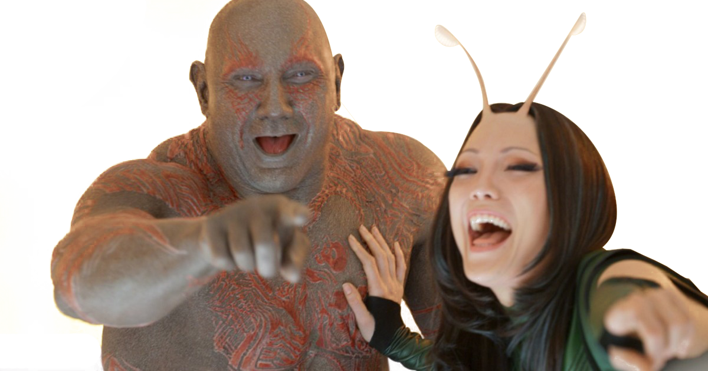
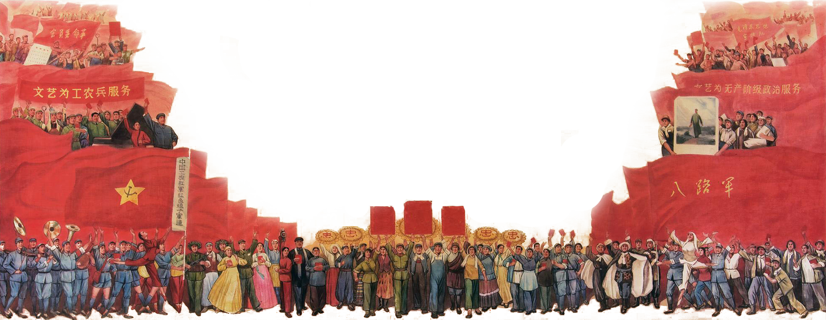

Notes:
State question

Slide 3
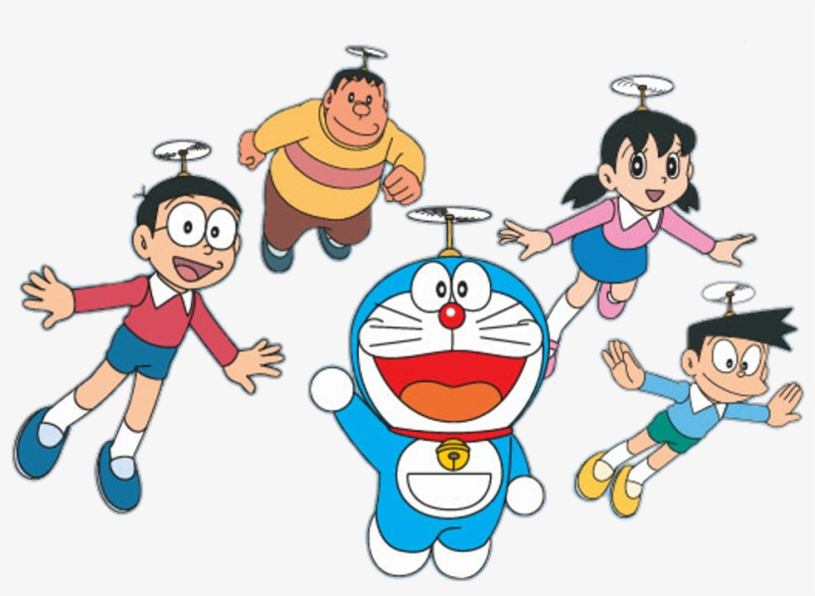



Slide 4

Just so you know, this is the video of the song

Slide 5


